Slide 1

Cancer and how it relates to different aspects of daily life.
Cody Carpenter
Jake Rohbock
Johnny Ramirez
Samantha McKay

Slide 2



Agenda
Is there a correlation between income and cancer rates?
Do older populations have greater or lower poverty rates?
Does a higher percent of married households correlate with lower incidences of death as the outcome?
What percentage of cancer incidences result in death in each state on average?
What is the relationship between unemployment and cancer incidence for each state?
Does having private insurance vs public insurance correlate with higher or lower death percentages?

Slide 3

Topic one
Subtitle

Slide 4
Topic one
Subtitle

Slide 5
Topic one
Subtitle

Slide 6
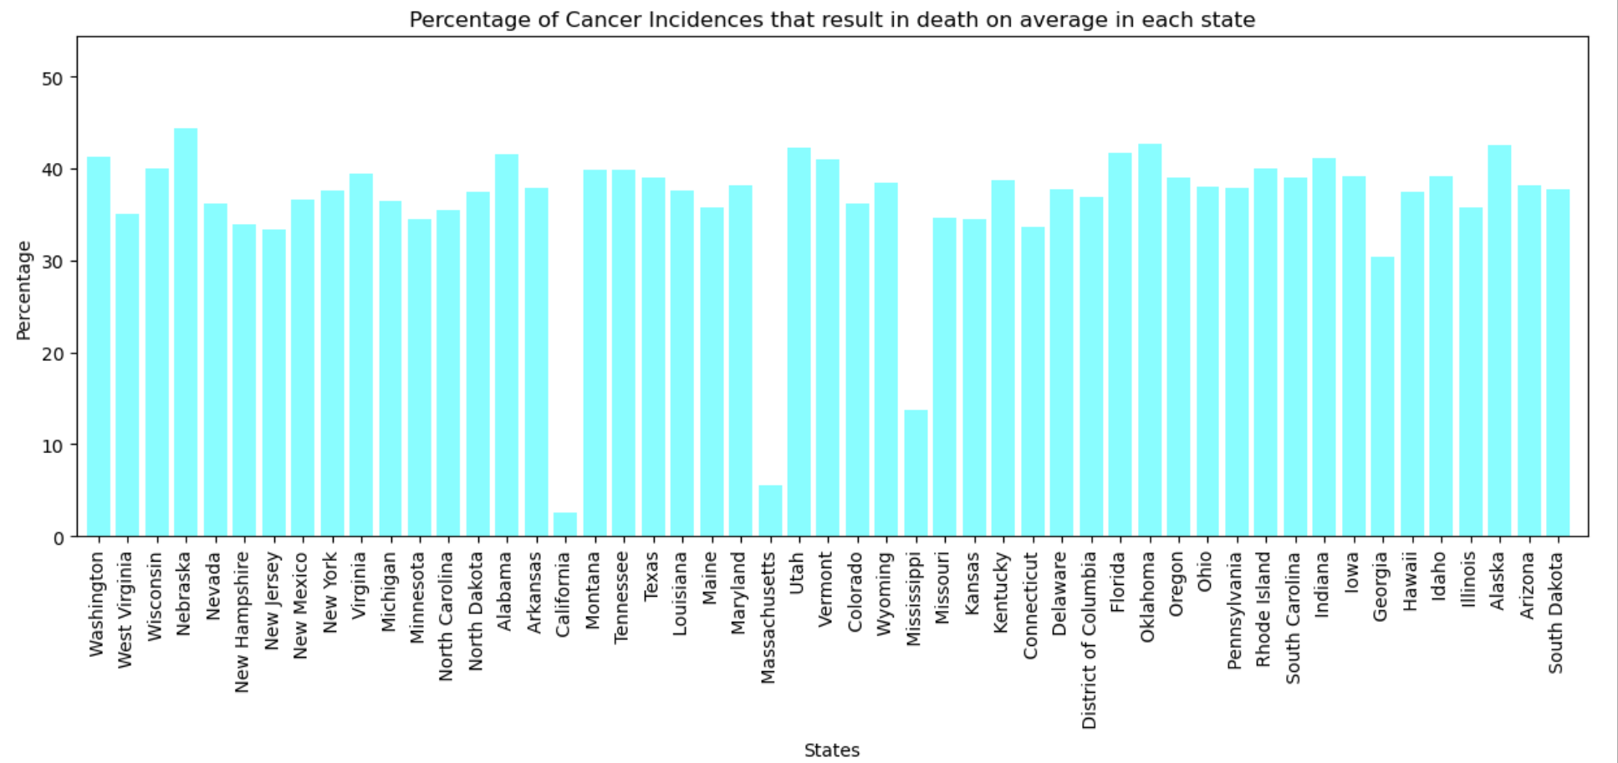
Percentage of cancer incidences resulting in death on average for each state
Notes:
X axis is represented with

Slide 7

Summary
With PowerPoint, you can create presentations and share your work with others, wherever they are. Type the text you want here to get started. You can also add images, art, and videos on this template. Save to OneDrive and access your presentations from your computer, tablet, or phone.

Slide 8


Thank You
Presenter name
Email address
Website address

